Slide 1


Slide 2



Supporting your child to understand what bullying is
and how it can effect others..

Slide 3
  Talk to your child and explain what bullying is and how it can make people feel.
  Some children and young people don't realise what they are doing is bullying, and how their words and actions effect others. It is important to let them know their behaviour is unacceptable and reassure them that you can help them to put it right.
  Teach empathy, ask your child to think about how they would feel if they were experiencing bullying.
  Sometimes, bullying is a communication that the child needs support. It is important to address the behaviour and find out what support the child needs.

Slide 4
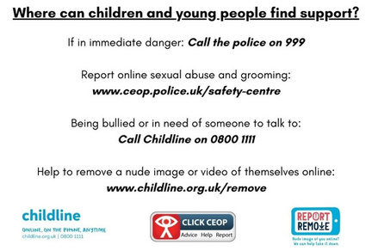





Who else can support us?

