Slide 1


Slide 2


Exam Stress
What is stress?
What does exam stress look like for me ?

Slide 3
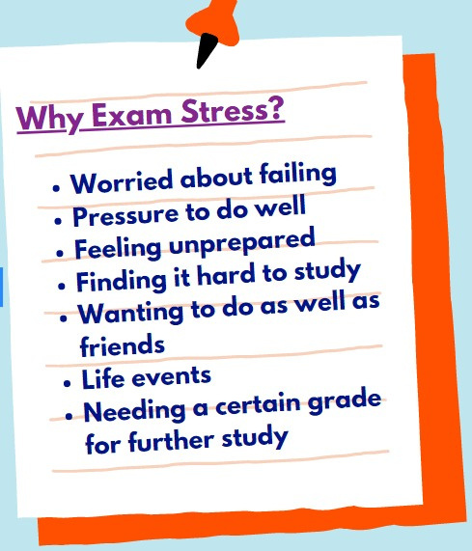
Stress
Stress is the body's reaction to feeling threatened or under pressure.
It's very common. in short bursts it can be motivating to help us achieve things in our daily life such as at school or home. Stress can become unhelpful to us if we experience it for longer periods of time and it begins to affect our health and wellbeing.

Slide 4

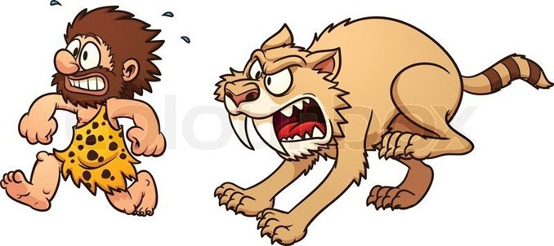
The science
When we feel stressed, our bodies react by releasing hormones such as adrenaline and cortisol.
This is our body's way of detecting a potential threat and trying to protect us.
This leads to a process called Fight...Flight...Freeze response which is triggered in stressful situations.

Slide 5



Physical Sensations
Thoughts
"I am going to fail" Preoccupied, worries ,future thoughts
tense, sick, headache, racing heart
STRESS
Emotions
Behaviours
overwhelmed, worried
low
procrastinate biting nails snapping at people

Slide 6




Five areas model
Thoughts
What if i fail ?
I am going to fail ! Everyone will do better than me
Emotions
Worried
Anxious
Frustrated
Behaviours
Avoid going
Not sleeping properly
Don't talk to anyone Struggle to concentrate
Situation
Exam
Physical sensations
Feel sick
Fast heart beat
Dry mouth

Slide 7
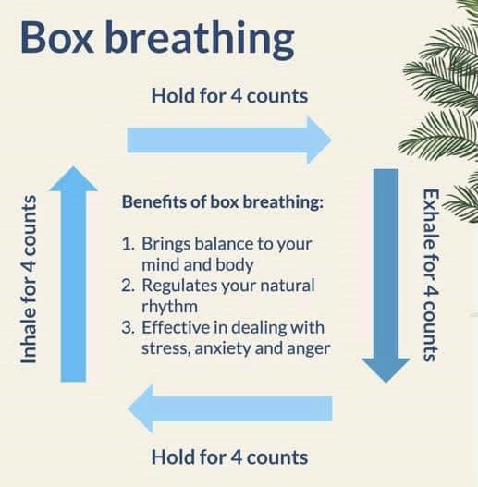
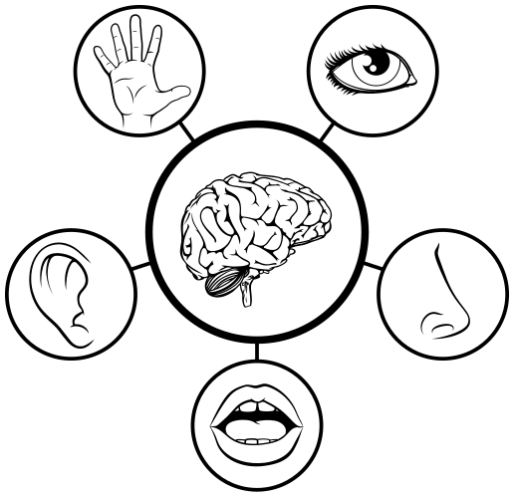
Managing physical sensations

Slide 8


The power of thought
THOUGHTS
FEELINGS
I'm going to fail this exam tomorrow
I feel sick and anxious
BEHAVIOURS Sit and cry Shout at my friend

Slide 9
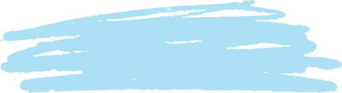
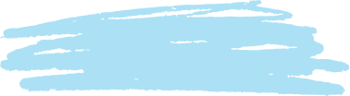




Challenging negative thoughts
What would i say to a friend?
In a day?
In a week?
In a month?
Will this matter..
Take it to Thought court
Evidence against
Evidence for

Slide 10
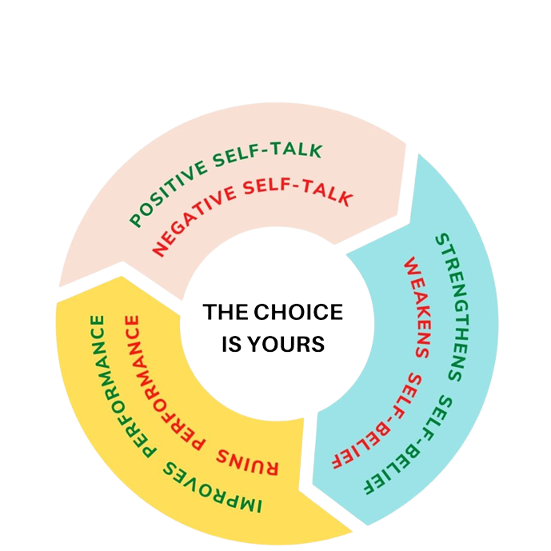
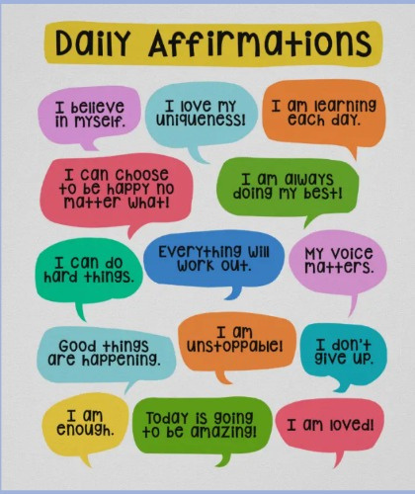
Positive affirmations

Slide 11


Exam run up
Look after yourself
Keep active
Balance

Slide 12
Revision
Time management
Realistic goals
Rewards

Slide 13
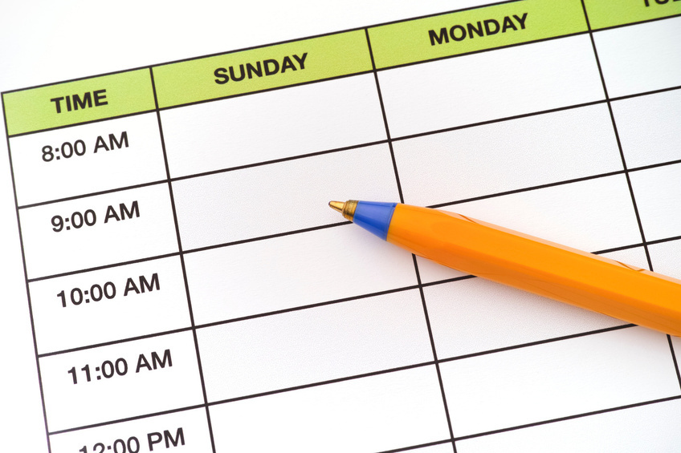

Coping with stress
Scheduling time and what you need to do
Create a revision timetable
Break down tasks into manageable chunks

Slide 14
During exams
positive affirmations
be prepared
Notice physical sensations

Slide 15
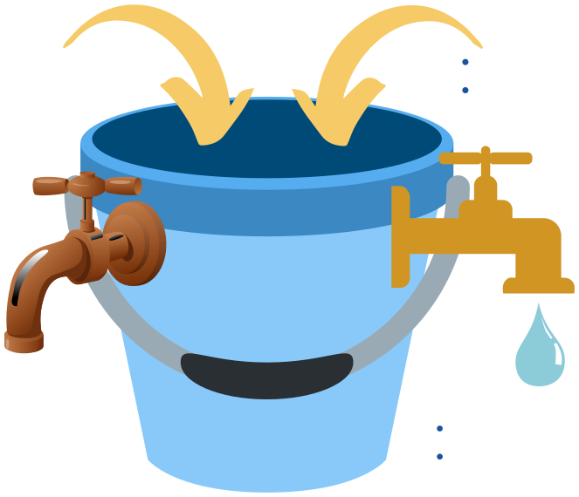
Stress bucket
  worry about exams
  friendship difficulties
stress at home not sleeping well
RUSTY TAPS
  alcohol/ drugs
  self-harm
  sleeping too much
  isolating self
GOLD TAPS
  engaging in hobbies
  speaking to friends and
  family
  listening to music

Slide 16


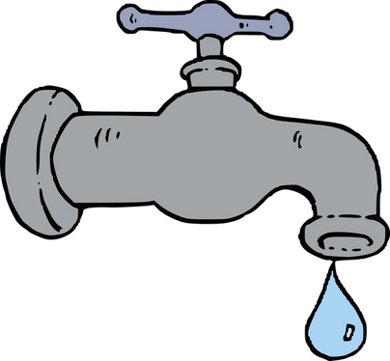
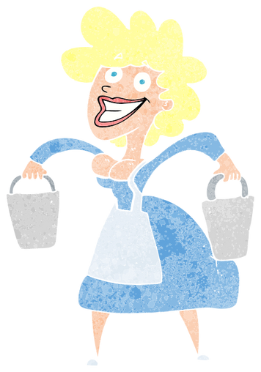
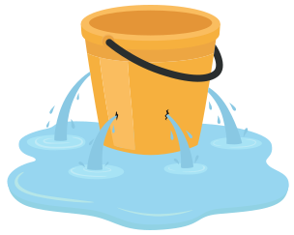
Managing a full stress bucket
Saying no
What is a priority? Pour some out
Is there someone who can help you carry the load?
Taking time out for relaxation

Slide 17
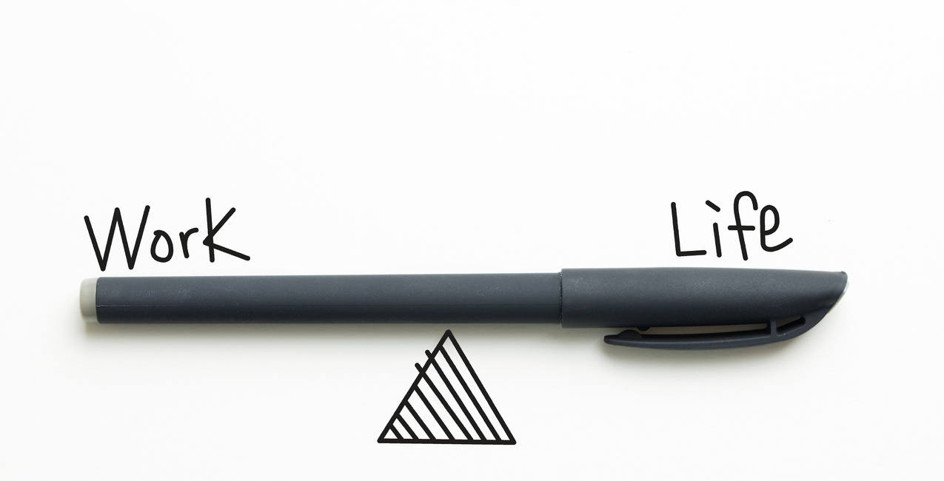
Coping with stress
Balance
Find your balance- take time out of studying to relax, see friends, and do fun activities

