Slide 1


Slide 2

Workshop Aims
  To understand what stress is. To understand the cycle of stress.
  To explore how to manage exam stress before, during and after exams.
  To learn strategies to help manage exam stress
  To understand support bubbles /where support is available.

Slide 3

Stress
What is it?
Discuss...

Slide 4


Stress
Worried about failing
Life events
Stress is the body's reaction to feeling threatened or under pressure. It's very common, in short bursts it can be motivating to help us achieve things in our daily life such as at school or home. Stress can become unhelpful to us if we experience it for longer periods of time and it begins to affect our health
and wellbeing.
Pressure to do well
Wanting to do as well as friends
Feeling unprepared
Needing a certain grade for further study
Finding it hard to study

Slide 5

Stress
Avoidance, procrastination, fidgeting, nail biting, snapping at friends
Tense muscles, feeling sick, tight chest, increased heart rate, headache, feeling dizzy
Behaviours:
Physical Sensations:
Feelings:
Thoughts:
Irritable, low, worried, overwhelmed
Pre-occupied with worry, racing or running away into the future

Slide 6

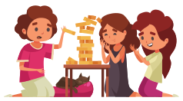


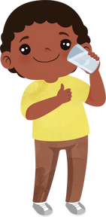

Managing Exam Stress
Eat Healthy
Do things you enjoy
Get some sleep
Drink lots of water
Keep Active
Before Exams
Looking after yourself is key

Slide 7



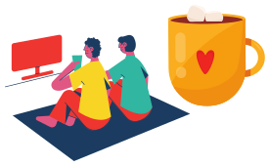
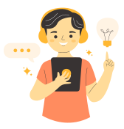
Managing Exam Stress
What's your learning style?
Set achievable goals
REWARDS
Time management
Avoid procrastination
Revision Tips
Know what works for you

Slide 8


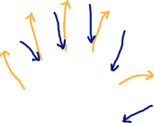
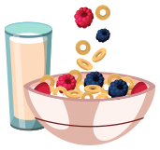



Managing Exam Stress
Have a good breakfast
Notice physical sensations
Positive affirmations
Use techniques to help
Be prepared
During Exams
Be prepared and stay in control

Slide 9
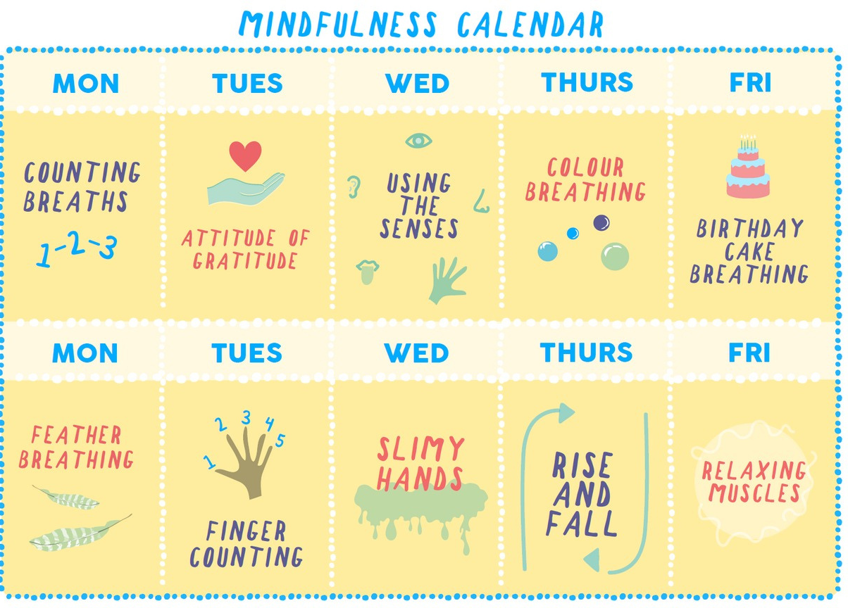
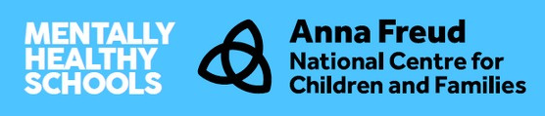
Managing Exam Stress
During Exams

Slide 10



Be kind to yourself
and others

Slide 11
Managing Exam Stress
Circle of Control
Distraction
Plan in the fun
Letting go of worries
Worry Tree
After Exams
What is still in your control

Slide 12
Circle of control
Make plans
with friends
Learn a new skill
Self-care
Don't compare your
answers with others
Spend time
with family
THE RESULTS
After the exams you have done all you can. Worrying about it now will not change the outcome!

Slide 13

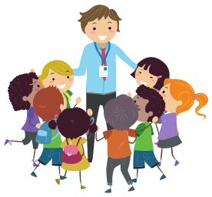
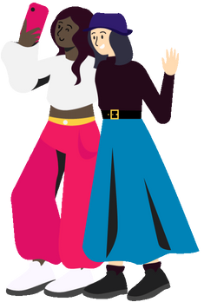
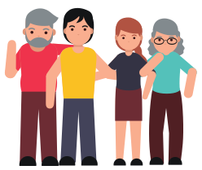
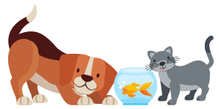
SUPPORT BUBBLES
friends
teachers and school staff
Pets
family

Slide 14
