Slide 1


Slide 2


What makes a good friend?

Slide 3
Healthy Friendship
Trust
Support
Respect
Compromise
Listening
Forgiveness
Boundaries
Apologising

Slide 4
Unhealthy Friendships
Not feeling supported
Rumours
Jealousy
Can't be
yourself
Feeling
left out
Controlling
Arguing frequently
Peer pressure

Slide 5


Imagine you are holding a glass of water.
If you hold the water out in front of you for 1 minute, it is not a problem.
If you hold it out in front of you for 1 hour, you will have an ache in your arm.
If you hold it for 1 whole day, your arm will feel very numb and sore.
The weight of the glass of water does not change, but the longer you hold it the heavier it becomes

Slide 6

The stresses and worries related to peer groups and friendships are like that glass of water, the longer you hold your worries in the more it will affect your body.
We are here to help you blow away the storms

Slide 7
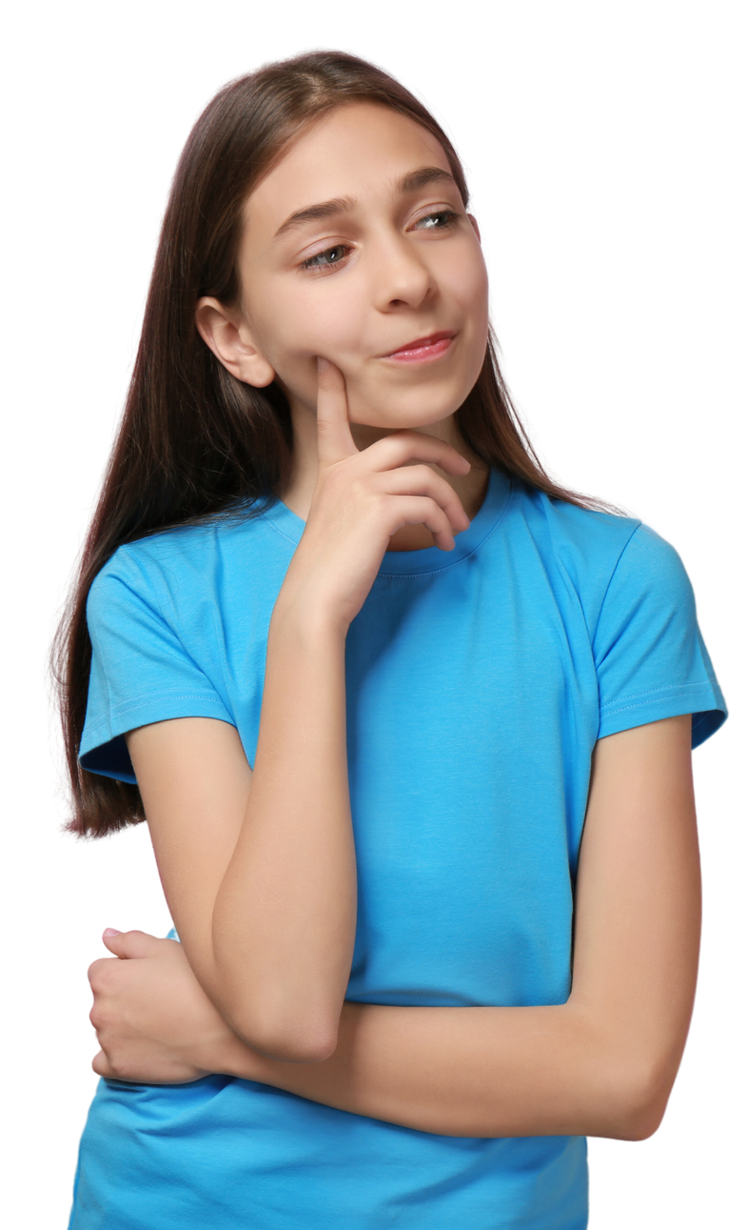
What is the difference between bullying and cyberbullying?

Slide 8
Bullying
Bullying is behaviour that hurts someone else. It includes name calling, hitting, pushing, spreading rumors, threatening or undermining someone.
It can happen anywhere – at school, at home. It's usually repeated over a long period of time and can hurt a person both physically and emotionally

Slide 9
Cyber-Bullying
Cyberbullying is any form of bullying which takes place online. This can be done over smartphones, tablets, online gaming, chat forums, social and other media.

Slide 10
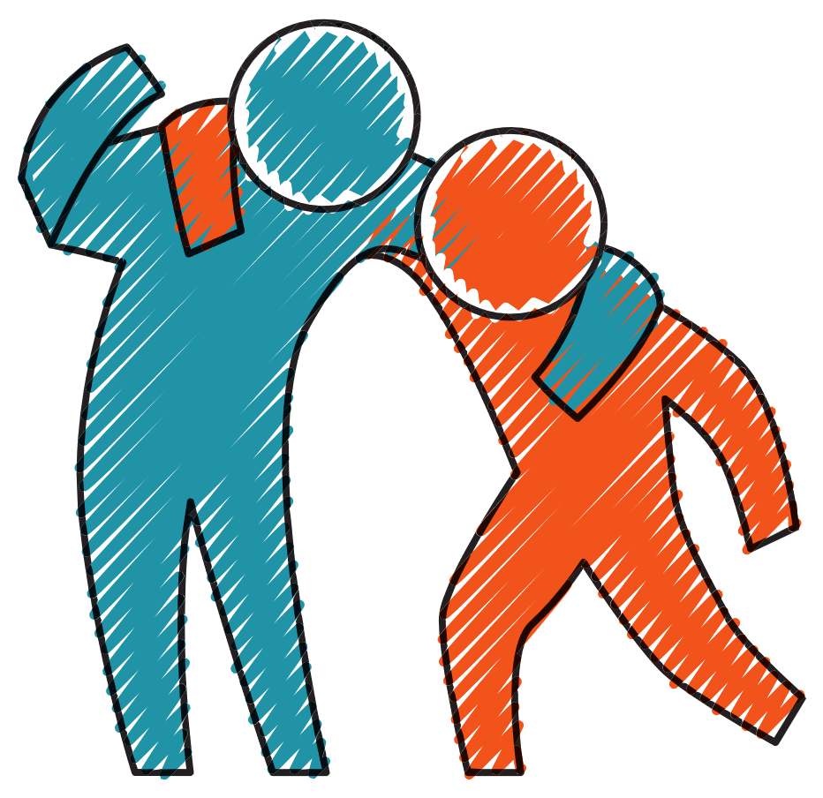
Helping a friend that is experiencing bullying/cyber bullying..
Things you can try to help a friend who is being bullied:
  Listen to them - it can be really helpful for them to have someone to talk things through with.
  Support your friend - offering to go with them toreport the bullying and help them think about what they want to say.
  Give them a compliment - this may help them feel likethey aren’t so alone when other people are posting negative messages.
  Do things together - this may help to take their mind off things for a short while. You could watch a DVD, play sports or go to the cinema.

Slide 11
Am I part of the bullying?
If you use digital technology to upset, anger or embarrass someone on purpose, this means you’re involved in online bullying. It might be as simple as ‘liking’ a mean post on Facebook or spreading a rumour on snapchat. The person being bullied could feel like you’re part of the bullying. It’s important to think about how we might feel if someone said the same thing about us.

Slide 12


Connecting with others online

Slide 13




Let's talk Social Media..
Are there more positives or negatives?
What are your experiences with social media? What apps do you use?
How does social media make you feel?
Do you know the age restrictions on Social Media app?
Are you being safe while using social
media apps?

Slide 14

Write on your star one thing you have remembered or enjoyed in today's workshop!

