Slide 1




ANTI-BULLYING
WEEK 2022

Slide 2
Anti-Bullying Week 2022: Reach Out
“
Bullying affects millions of lives and can leave us feeling hopeless. But if we challenge it, we can change it. And it starts by reaching out.
It doesn’t stop with young people. From teachers to parents and influencers to politicians, we all have a part to play. Reach out to someone you trust if you need to talk. Reach out to someone if you know they’re being bullied. Reach out by being the change you want to see.
It takes courage, but it can change lives.
So, this Anti-Bullying Week, let’s come together and reach out to stop bullying.
“
Anti-Bullying Week 2022 – Reach out
2

Slide 3
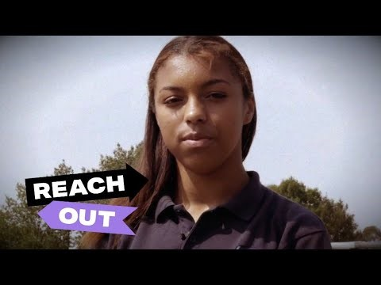

https://www.youtube.com/watch?v=kjhp-67cKJA
Anti-Bullying Week 2022 – Reach out
3

Slide 4
What is bullying?
‘The repetitive, intentional hurting of one person or group by another person or group, where the relationship involves an imbalance of power. Bullying can be physical, verbal or psychological.
It can happen face to face or online.’
Anti-Bullying Week 2022 – Reach out
4

Slide 5




Types of bullying
PHYSICAL
VERBAL
Includes hitting, kicking, tripping, pushing or purposefully damaging other people’s property.
Includes name-calling, threatening, teasing, saying nasty or rude things to someone.
psychological
ONLINE
Includes spreading lies about someone, playing nasty jokes or excluding people.
Includes hurtful comments / messages / posts, excluding on purpose, spreading nasty gossip and imitating others online.
Anti-Bullying Week 2022 – Reach out
5

Slide 6

Take a moment to consider …
Two times you have reached out to someone in need
1
Two times someone has reached out to you when you needed help
2
Anti-Bullying Week 2022 – Reach out
6

Slide 7
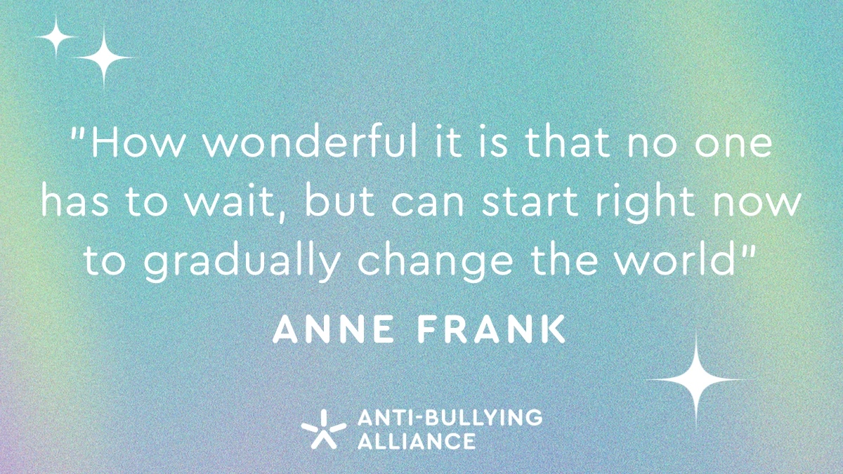
Anti-Bullying Week 2022 – Reach out
7

Slide 8
Who can we reach out to in our school?
1
Staff Name here
2
Staff Name here
3
Staff Name here
Anti-Bullying Week 2022 – Reach out
8

Slide 9
Thank you for being a part of
ANTI-BULLYING
WEEK 2022

