Slide 1
ANTI-BULLYING
WEEK 2022
Primary School Lesson

Slide 2
What is bullying?
“
Bullying is the repetitive, intentional hurting of one person or group by another person or group, where the relationship involves an imbalance of power. It can happen face to face or online.
“
Video: https://www.youtube.com/watch?v=U8iX-rstY9I
Anti-Bullying Week 2022 – Reach out
2

Slide 3
https://www.youtube.com/watch?v=aMfgZRdVbdw
Anti-Bullying Week 2022 – Reach out
3

Slide 4
?
How can we reach out to others?
Anti-Bullying Week 2022 – Reach out
4

Slide 5
Who might be involved in a bullying incident?
How many people?
What are they doing?
Anti-Bullying Week 2022 – Reach out
5

Slide 6
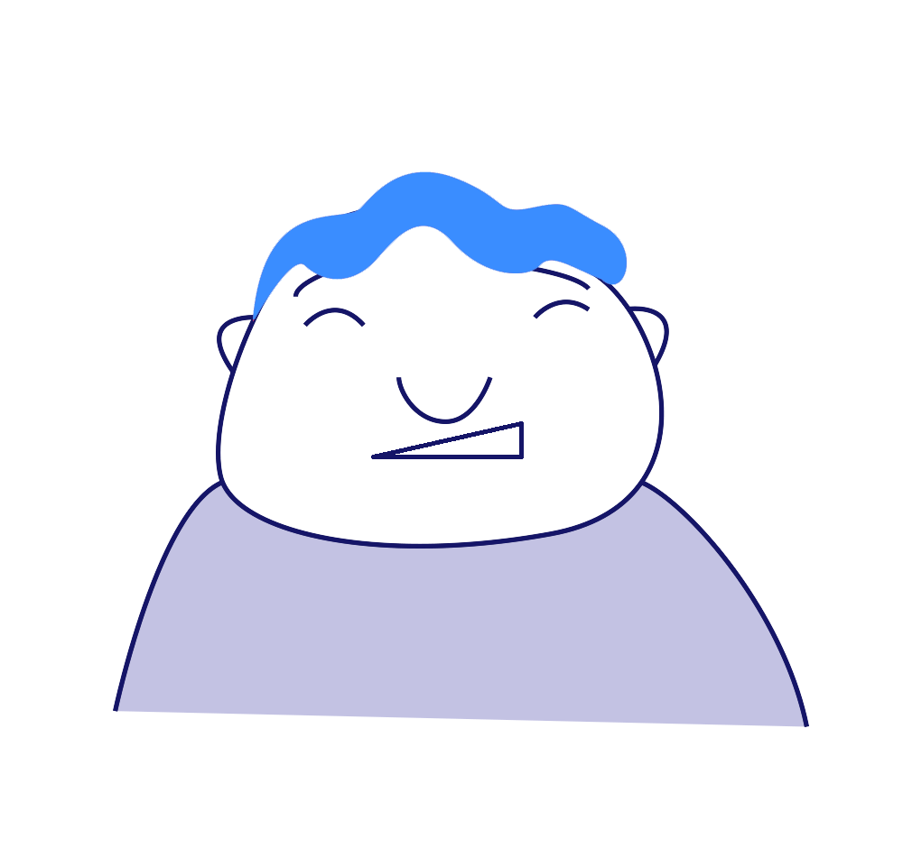
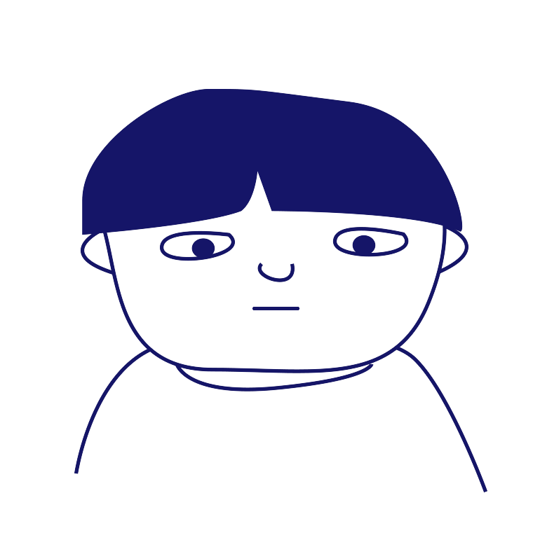
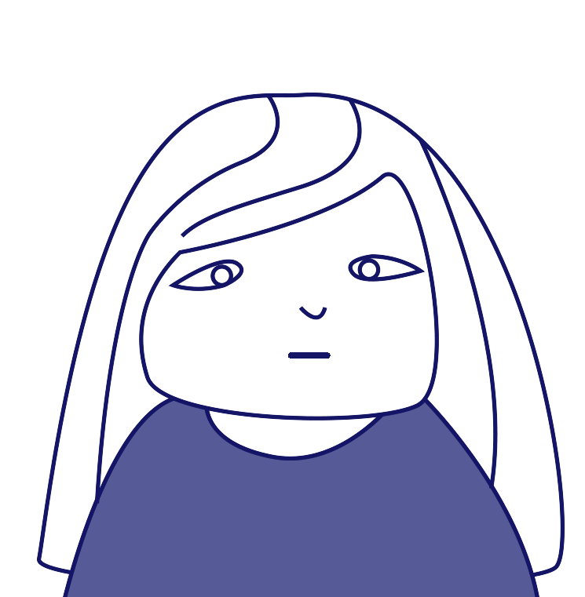
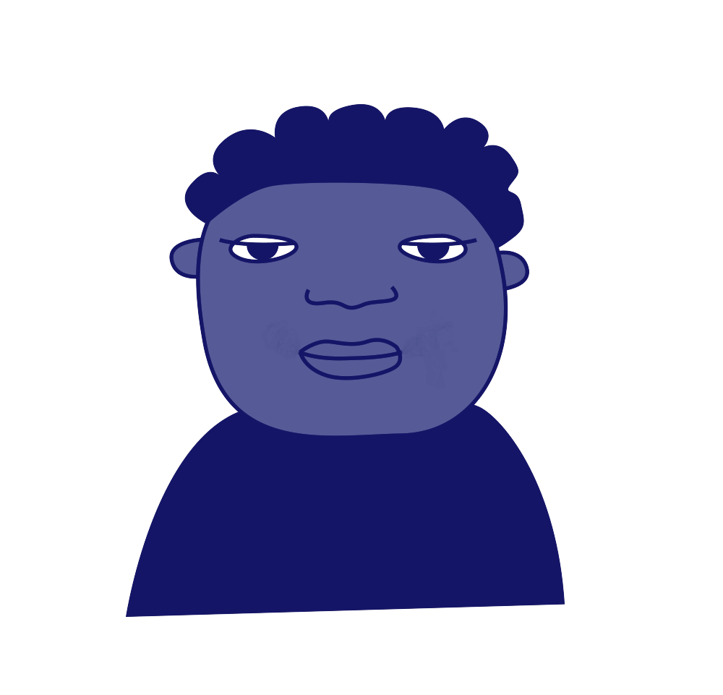
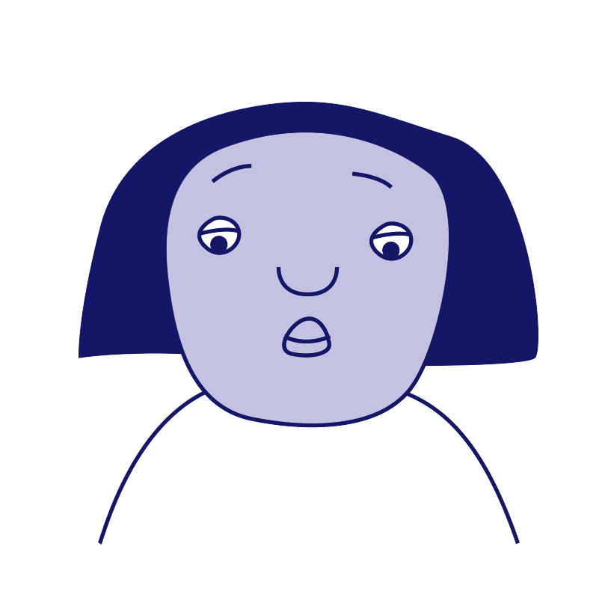
Roles involved in bullying
‘Ringleader’
‘Assistant’
‘Target’
‘Outsider’ or ‘Bystander’
‘Defender’
‘Reinforcer’
Anti-Bullying Week 2022 – Reach out
6

Slide 7
Scenario
1
Every time Rhys goes onto the field at break time, a group of girls follow him around and are unkind to him. Two of them shout names and make fun of his hair, and the rest of them watch and laugh along.
Which roles can you see in this scenario? How could each person reach out?
Anti-Bullying Week 2022 – Reach out
7

Slide 8
Scenario
2
Whenever Janai joins an online game on her PlayStation with her classmates, Dylan always tells other children to leave the game and start a new one without her.
Which roles can you see in this scenario? How could each person reach out?
Anti-Bullying Week 2022 – Reach out
8

Slide 9
Scenario
3
Vanisha has noticed that every time her class line up for lunch, there are some children who are pushing Erin around.
Which roles can you see in this scenario? How could each person reach out?
Anti-Bullying Week 2022 – Reach out
9

Slide 10
Scenario
4
Jac is often told by Sofia to spread unkind rumours about Amelia by whispering and passing notes around.
Which roles can you see in this scenario? How could each person reach out?
Anti-Bullying Week 2022 – Reach out
10

Slide 11
Who can we reach out to in our school?
1
Staff Name here
2
Staff Name here
3
Staff Name here
Anti-Bullying Week 2022 – Reach out
11

Slide 12
Thank you for being a part of
ANTI-BULLYING
WEEK 2022

