Slide 1




ANTI-BULLYING
WEEK 2022

Slide 2
What is bullying?
Anti-Bullying Week 2022 – Reach out
2

Slide 3
What is bullying?
Bullying is the repetitive, intentional hurting of one person or group by another person or group, where the relationship involves an imbalance of power.
It can happen face to face or online.
Anti-Bullying Alliance agreed definition
Anti-Bullying Week 2022 – Reach out
3

Slide 4
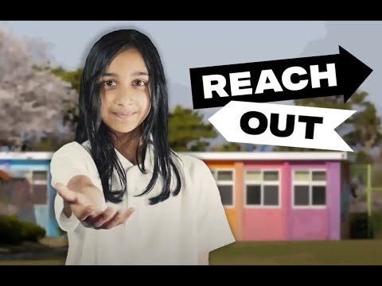

https://www.youtube.com/watch?v=aMfgZRdVbdw
Anti-Bullying Week 2022 – Reach out
4

Slide 5

Friends?
1
How could we reach out to…
Teachers and school staff?
2
Parents and Carers?
3
Yourselves?
4
Anti-Bullying Week 2022 – Reach out
5

Slide 6
Who can we reach out to in our school?
1
Staff Name here
2
Staff Name here
3
Staff Name here
Anti-Bullying Week 2022 – Reach out
6

Slide 7
Thank you for being a part of
ANTI-BULLYING
WEEK 2022

